Slide 1
Situational Analysis of Pig Industry and incursion of African Swine Fiver in Sierra Leone
BY
Sahr Raymond Gborie
Ministry of Agriculture and Food Security
Sierra Leone
February 2023

Slide 2
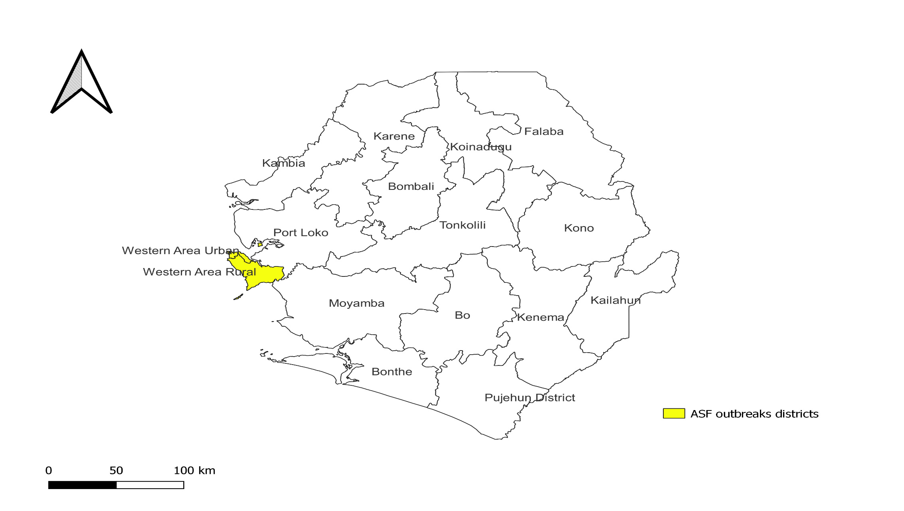
Current Status of pig Industry in Sierra Leone
Pig production is mainly small-scale traditional using indigenous breed of pigs
Few farmers keep exotic breeds, mainly large white, land race and Duroc
Estimated population of pigs:57,877 pigs representing 1% of the total livestock
It widely distributed nationwide managed under two production types
Importance of pig production
Improve income and livelihood of small -scale farmers
Contribute to nutrition and food security

Slide 3
ASF Situation in Sierra Leone..1/2
African Swine Fever (ASF), among Sierra Leone listed priority animal diseases for surveillance
On September 2019,outbreaks of ASF reported in Western Urban district of Sierra Leone
The cumulative pig deaths were estimated at, 1,040 out of 1,080 reported sick (CFR 96%)
National One Health multi-sectoral approach was used to response to ASF outbreaks

Slide 4
ASF Situation in Sierra Leone..2/2
ASF samples collected : 339
Sample types:
whole blood, serum, oral swabs, nasal swabs, fecal samples and organs
ASF samples diagnosed
Central Veterinary Laboratory(CVL) Teko
University of Makeni for Swine Flu
Samples referred to reference laboratory:
Animal Disease Diagnostic Laboratory Plum Island Animal Disease Center in the United States of America
ASF confirmed positive by ELISA and real-time PCR

Slide 5
Main Challenges of ASF Control
No ASF specific surveillance plan - future plan to develop one
Inadequate mass media and community engagement programs on ASF:
Inadequate laboratory reagents and consumables to carry out ASF diagnosis
Inadequate funding to support operation of ASF control

Slide 6
Ongoing ASF Research
One research activity conducted on ASF in country
No established ASF Sentinel surveillance
No dedicated support on ASF research

Slide 7
Thank you Merci Obrigado

